Slide 1
SysMD v3 Architecture & Testing Concept
Christoph Grimm, Moritz Schuler, Sebastian Post
RPTU Kaiserslautern-Landau
Chair of Cyber-Physical Systems

Slide 2
Architecture v2 Nightmare
Parser
Translates Text to Model Elements
Model Resolve Names, Inheritance, static checks
Compiler generates Model (per se nice and ok)
Both tightly interwoven and each quite complex
Model also implements computation of expressions (hmm …)
Now, even more complex computation / dispatcher added on top
Model also interwoven with solver (ups …)
The ultimate nightmare … make one mistake and enjoy test & debug!
API and interfaces exist … but do not reduce complexity effectively because of complex dependencies
Modification of single part needs and impacts the whole
Bad for understanding, testing, re-use, …
Solver Check consistency

Slide 3
Objectives of Refactoring v2 to v3
Significantly improve Testability, Diagnosability
Problem: many tests involve Compiler, Model or even Solver.
… not really unit tests, rather random coverage, hence lack systematic test/coverage.
Better: separation of compiler, model, solver by API with basic needs, less dependencies.
Allow Modular (Re-)Use
Problem: no way to (re-)use modules independent from each other.
Better: allow use of compiler, solver, model separately in spin-off projects.
E.g., Backend repository-only, Web-UI only, Notebook, …
Easy exchange parts against others in case there is OMG standard module (model!)
!! Lower entry hurdle for contributors !!
Problem: contributors/students fail mastering huge, historically grown code base.
Better: avoid need to understand complete code-base and its interactions.

Slide 4
Architecture v3 Concept
Compiler generates API elements, not meta-model inst., reports Issues
Makes compiler easier – semantic rules create Element data models only.
Semantic checks and name resolution postponed to model.
Repository persists API elements (and non-standard, internal ElementData)
Libraries, Projects w/ usages
Internally allowed: references between libraries, projects, late “linking”, ref. to source code
Model imports (extended) Element data models, reports Issues
Builds Metamodel instances, links libraries, projects
Resolves names and feature chains
Does checks: Co/Contra/Invariance (Classes using Ranges library) following Liskov pr.
Solver imports Model, reports Issues (inconsistency, lack of satisfiability, …)
Computes (over-approx.) of consistent valuations of all variables, considering expressions
Reports possible value-ranges for all variables incl. multiplicities
WiP: Dispatcher

Slide 5
Separation
Model, Compiler
Simplifies sem. actions & unit testing
Notebook (Web/React by Industry, or KMP as on Github)
via SessionService (Rest or PIM)
ElementData, Status w/Issues
Status (Issues)
Status (Issues, Values)
Parser
Translates Text to ElementData (and Status)
Model Resolve Names, Inheritance, static checks
Metamodel Elements
Solver Variables, Expressions,
KerML SysML v2
ElementData
ElementDAO
Element from API spec
ElementData :> ElementDAO
Added for error reporting: Input, line, indices, ErrorElement.
Added for “linking” of unresolved references:
Identified(id: UUID)
IdentfiedByName(name: String), can be qualified name or feature chain relative to owning element.
Variable
Create Instances for inherited Features
Value Domain (Range, BDD) Model
Only base types, quantities, arrays/vectors
Export for usage in e.g., Z3, Sat4j & built-in-solver
Libraries, Projects compiled, tested, persisted separately.
No “dependency problems”, sep. versioning
Libraries,
Projects
Separation Model, Solver
More directed tests of dispatcher,
variable generation,
solver

Slide 6
Unit Testing Approach for v3
Compiler
Very simple directed tests – related to single cause of error
Production rules accepted: Check Elements are generated & correctly linked in ElementData
Faulty programs not accepted: Check Errors are reported
Model
Import of ElementData/ElementDAO : Model correctly created and elements linked?
Name resolution of Qualified Names and Features chains, external references can be resolved?
Redefinitions
Addition of implicit elements OK?
Default multiplicities for Features, Types, Usages OK?
Solver
Generation of variables tests: Mapping of features, inherited features to base types, quantities, vector OK?
Dispatcher for overloaded expressions OK? (WiP)
Discrete solver tests, Continuous solver, solver interaction and convergence tests.
Expressions calculated correctly? Constraints considered globally?

Slide 7
Lessons learned, Problems (still learning, as WiP)
(Unit) tests can become more specific – but re-writing needed, tests are longer as model does not support access etc. – separation useful, but costly – benefit rather in implementation, use cases --> We make small, initial test without model, bigger with.
Compiler can be separated from model with little effort
Significant reduction of complexity for compiler, semantic actions just collect data
Better testability (unit tests) at increased effort, but much easier debugging by introspection
UUID 5 still ugly and not yet nice solution.
Currently: 1st run with UUID4, standard libraries get v5 on export, but with too-big-complexity.
Model benefits less from compiler, but high profit from separation of model from evaluation and solving (right side!).
Generation of variables and equations on base-types not trivial, requires effort. But good! Keep it.
Less regression issues (and, maybe, benefit for use cases) by the external, name-based references in libraries and (API!) usages. Keeping it, add dependency management.
Currently only internal but might be candidate for standardization after improvements.
Very small effort, high benefit! Libraries can be easily combined to set up minimal testing environments (e.g., Base + ScalarValues only, reducing debug effort/complexity strongly)
Nice, but maybe rather from re-use perspective
Very useful for advanced evaluation,
dispatcher,
Best tradeoff effort/ seen benefit!

Slide 8
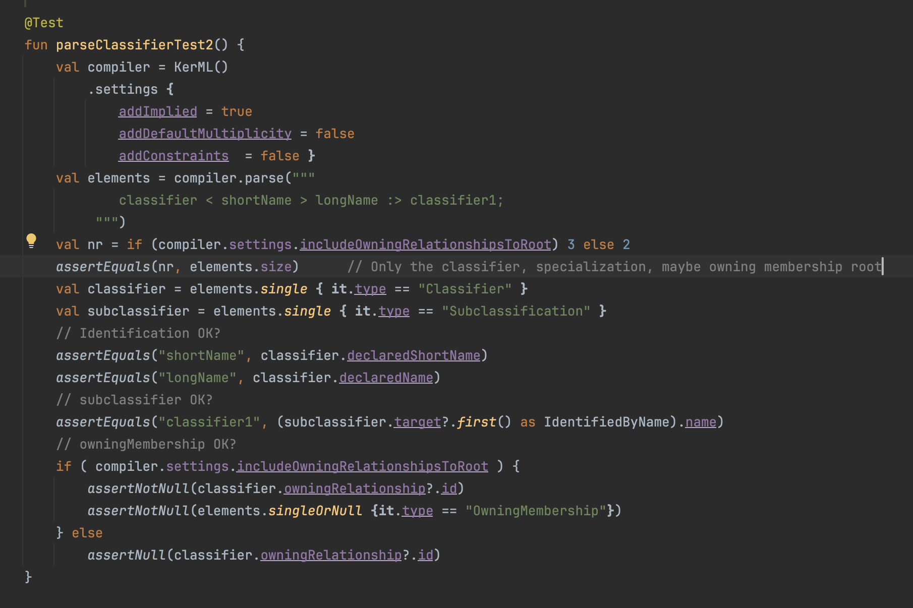
Examples: comparison unit tests (compiler only) More code for test … but better traceability of bugs Good for simple checks.
Note: Code left is Kotlin Multiplatform (which IntelliJ IDEA translates to & from Java) & can generate JVM Bytcode, various binaries, Javascript, Webassembly, Android, iOS …
Test must directly check fields of data elements No hierarchical structure unless following UUIDs, no name resolution

Slide 9
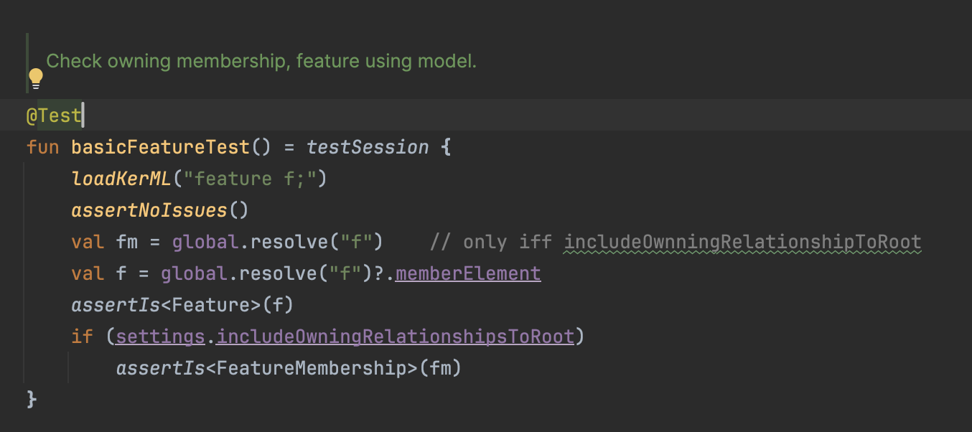
Examples: comparison unit tests (with model) Less code … but debugging goes via model, runs only if model is available
Name resolution helps … Access to dedicated fields helps ….
… if implemented and not involved in error.

Slide 10
Summary
First impression
Structuring into independent modules as described is possible and good
… reduces implementation and v&v effort
… maybe opens re-use for re-use in other applications
… likely reduces entry hurdle for contributors
Implementation ongoing and not finished
Nice: less then 100 tests of 1600 failing in branch …
Not so nice: expressions by far not yet finished
open issues (type system?, operand overloading semantics?, dispatchers big WiP)
even grammar requires some more work (ANTLR 4, generation from EBNF)
But hope it will profit much from (and has driven) refactoring to v3

